Slide 1
Conservation for Wildlife is Lacking Implementation in Okanagan, BC
By Jollee Perrier
Habitat Sustainability Committee for BCWF
Photo by: SOSCP 2020

Slide 2
The Policy Problem
Existing conservation measures for wildlife, specifically amphibian and reptiles in the Okanagan are lacking of implementation
Roads and development are in and through these species critical habitats
Critical habitat: defined in Species at Risk Act as “necessary for the survival or recovery”
Species at Risk Act (SARA): is federal legislation to prevent wildlife species from becoming extinct and to provide for their recovery

Slide 3
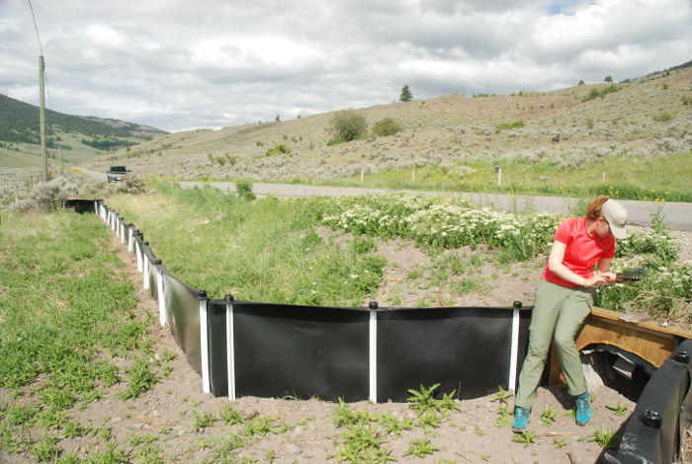
Why I Chose this Problem
Worked in White Lake Basin
Eco-passages (culverts) with directional fencing help mitigate road mortality snakes
Legal briefing assignment I did on Species at Risk act (SARA)
Implementation is lacking throughout Canada
Legal gaps
Photo by Jade Spruyt

Slide 4
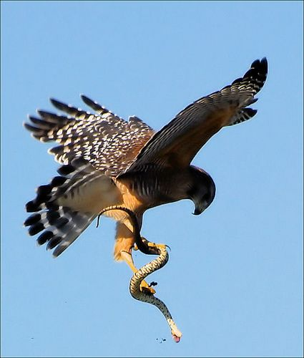
Why are reptiles and amphibians important?
Aid in scientific advances
Medicine
Bio-indicators for environmental health
Play critical roles in food web and trophic status
Prey and predators

Slide 5
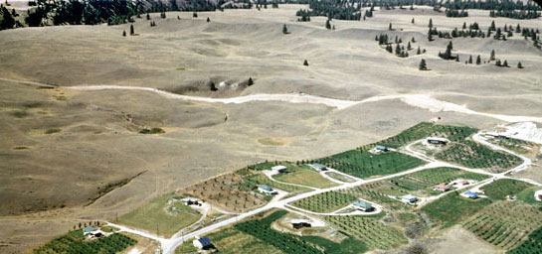
Background
Primary threats:
Habitat loss and fragmentation
Roadkill
Current mitigation
Wetland board walks, eco-passages, provincial and protected parks, education
Current legislation protecting wildlife in BC
the Wildlife Act, Land Act, and Forest and Range Practices Act
BC government signed National Accord for the Protection of Species at Risk
Never followed through and created stand-alone legislation for protection of species-at-risk
Photo by Stephen Cannings

Slide 6
Legal gaps
Include:
Lack of political will
Lack of requirements and application
Despite tons of recovery strategies and plans actual implementation is small
SARA applies to federal land only (BC = 1%)
Lack of data
→ This causes implications because species-at-risk are time sensitive
pro-longing processes

Slide 7
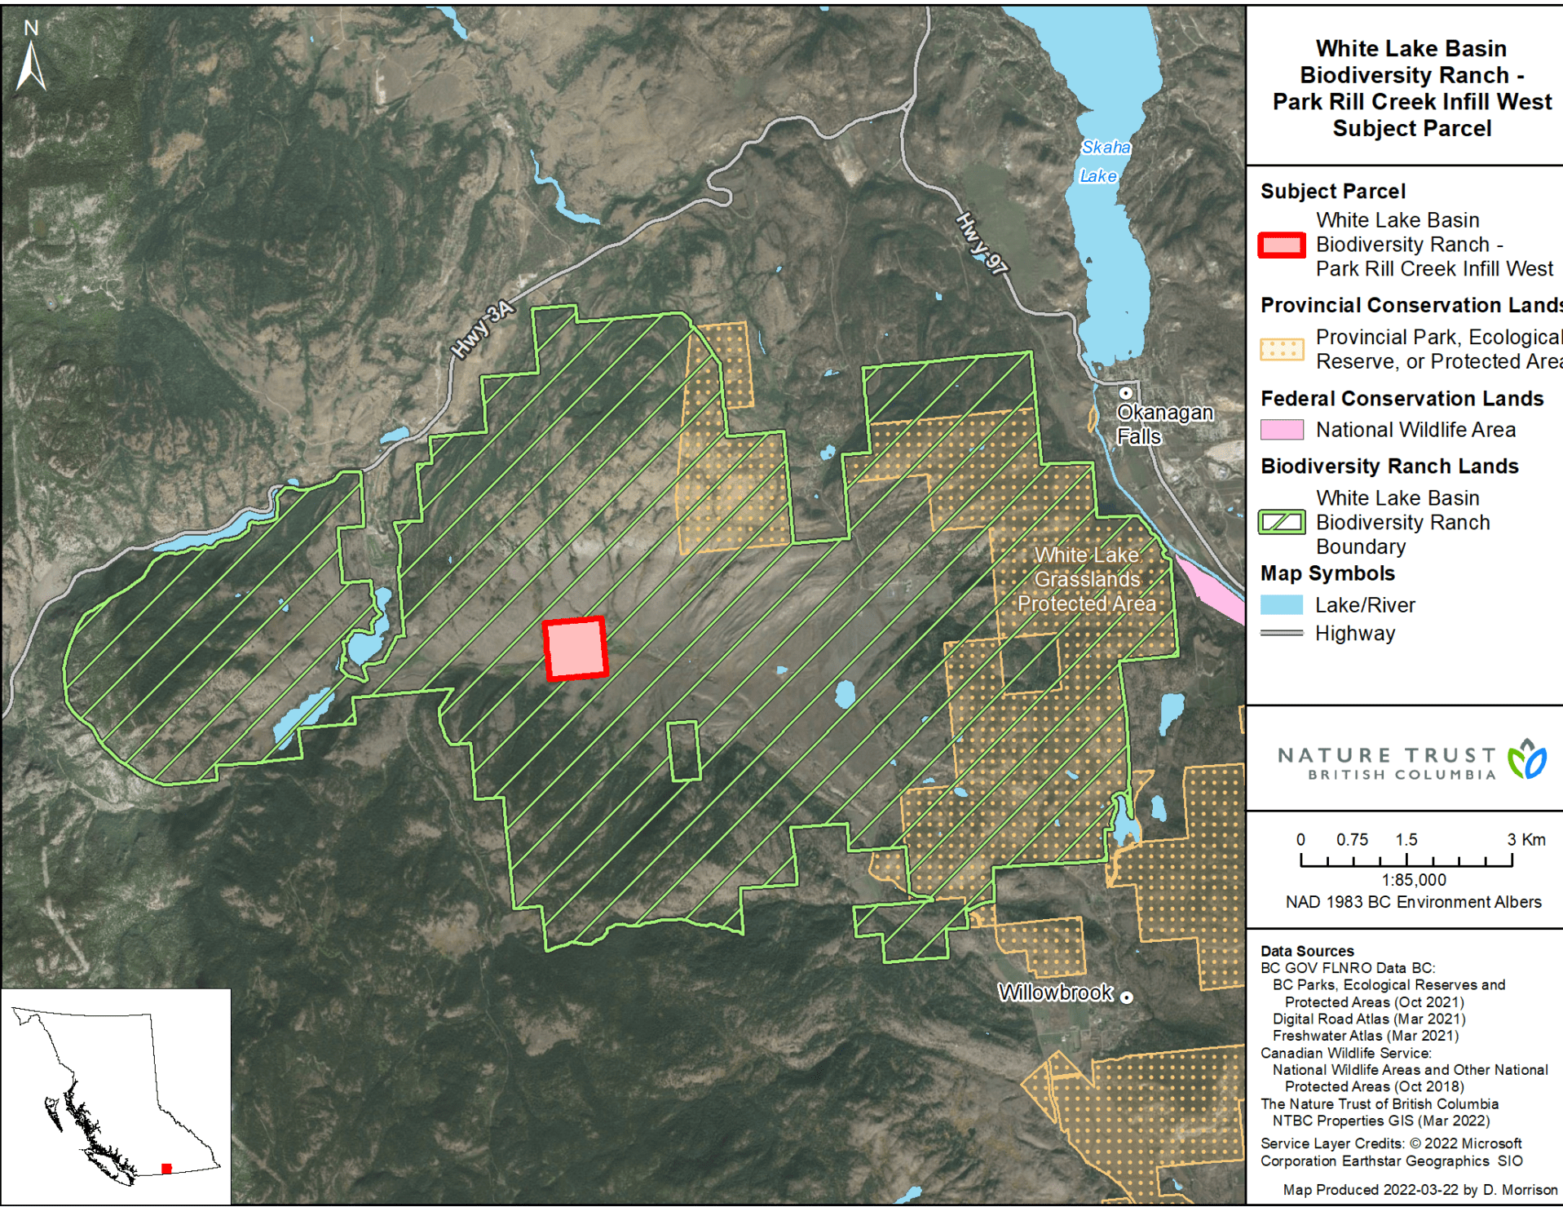
Stakeholders
Provincial Land and Parks
First Nation Groups
Ranchers
Recreationists
Conservation groups
Nature Trust
Grassland Conservation Council
Public

Slide 8
Policy options
No action, maintain status quo
Create stand-alone species-at-risk legislation for BC
Create species at risk task force for Okanagan (and surrounding area)
Amend and update current policies that protect species-at-risk
Map out all critical habitat for each species under SARA

Slide 9
Decision Support
Criteria | Measure | Most desirable | Moderately desirable | Least desirable
Cost to Ministry of Environment | Government cost for creating policy | High cost* | Medium cost* | Low cost*
Cost of Implementation | Annual costs to municipalities for conservation projects | High cost* | Medium cost* | Low cost*
Effectiveness of conservation efforts | Reduced reptile and amphibian mortality and habitat loss | High | Medium | Low
Completion of conservation efforts | Number of projects completed within critical habitat | High | Medium | Low
*Most desirable for governments would have a low cost and least desirable would have a high cost

Slide 10
Policy recommendation
Immediate action:
- Create stand-alone legislation for protection of species-at-risk
This allows creation task force for Okanagan
Funding for provincial led research and planning
Increased delegation of conservation work to municipalities

Slide 11
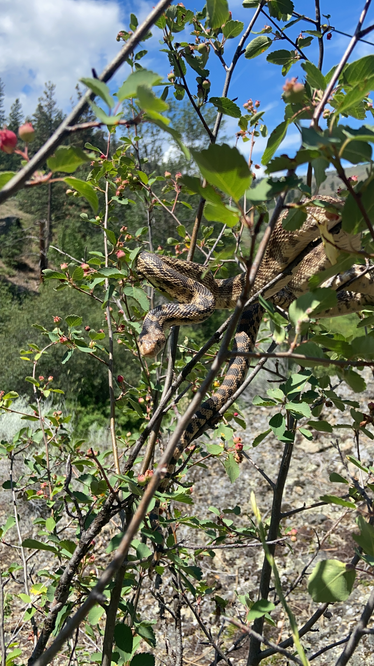
Any questions?

